Slide 1
Interview reservation system
By: Bharath Palanisamy, Joseph Mackie, Hishaam Ahamad, and Borjana Velu

Slide 2
Agenda
Summary of the system
High level design and patterns
Network Diagram
Technologies used
Process flows
Demo

Slide 3
Summary
Allows candidates to create account for security
Allowing companies and candidates to agree upon an interview.
Allowing the company and candidates to share their availability.
Allowing integration with Google Calendar.
Canceling or editing an interview.
Reporting the interviews scheduled.

Slide 4
High Level Design and Patterns
Gatekeeper
Handles external requests
Authenticates and Authorizes the User
Forwards request to the internal service
Reporting
Handles reporting requests
Internal Services
Security
Communications
Configuration
Availability
Candidate
Employee
Scheduling
Calendar
Patterns:
Gatekeeper
REST
Database per Service
Pub/Sub

Slide 5
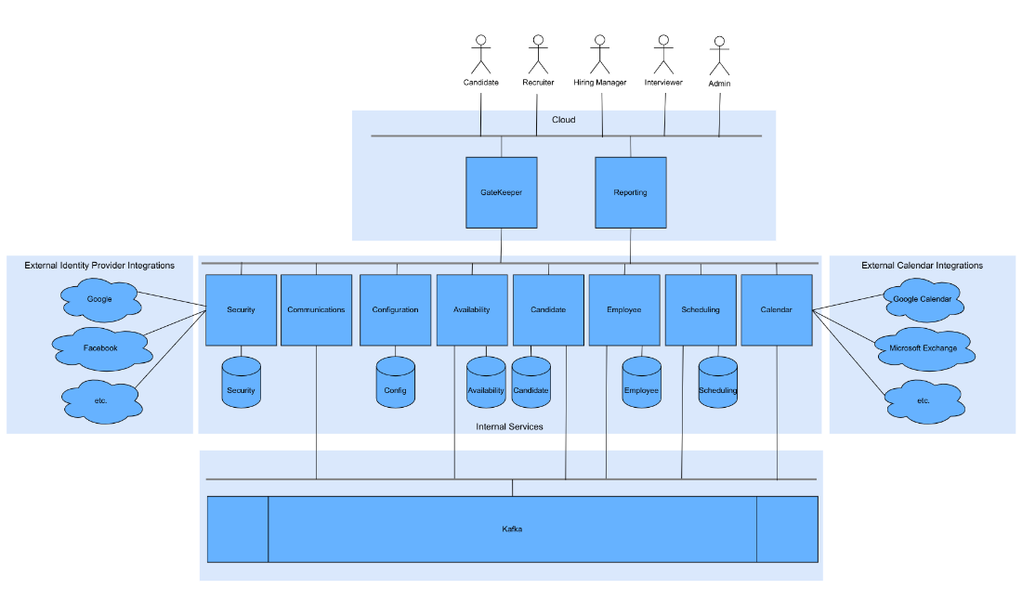

Slide 6
Technologies Used
Web Development
Language: Python
Web Framework: Flask
Authentication Mechanism: JWT Token
Data Development
ORM: SQLAlchemy
Database: Postgresql
Service Integration: Kafka
DevOps
Container Creation: Docker
Container Registry: DockerHub
Service Orchestration: Kubernetes
Cloud Platform: Okteto
Source Control: Git
Source Control Repository: Github
Build and Deployment Tool: Github Actions

Slide 7
Challenges Faced
Integrating authentication and authorisation with the security service database presented challenges that were overcome by using the ORM
Understanding the correct properties for the request objects.
The service IP addresses are used to resolve issues faced when sending requests via the FQDN.
Exponential number of connections

Slide 8
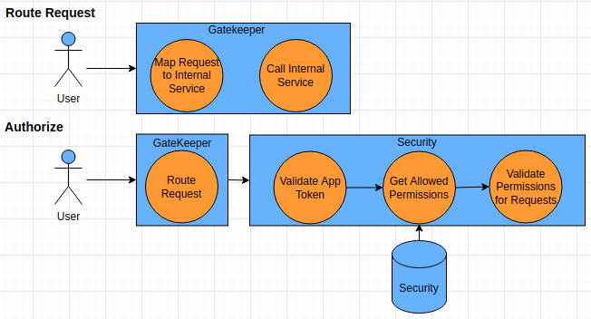
Gatekeeper Service Process Flows

Slide 9
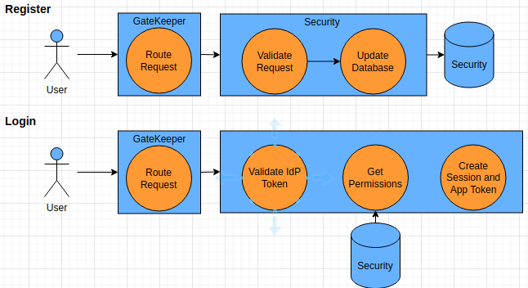
Security Service Process Flows

Slide 10
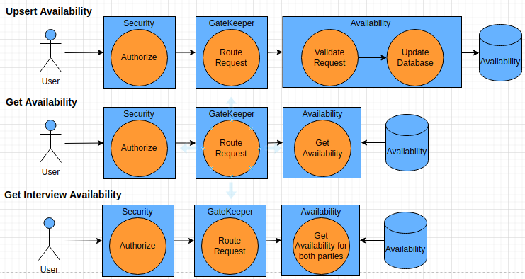
Availability Service Process Flows

Slide 11
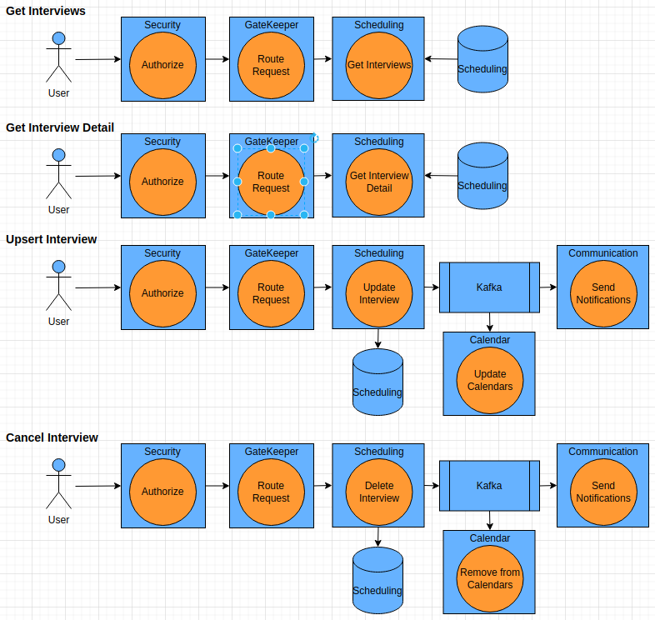
Scheduling Service Process Flows

Slide 12
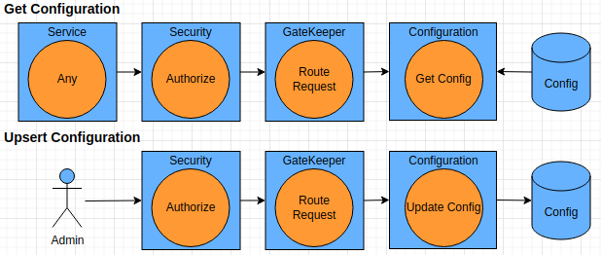
Configuration Service Process Flows

Slide 13
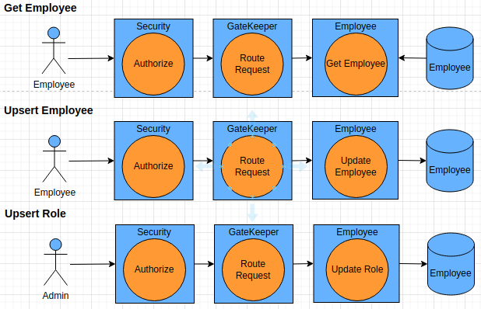
Employee Service Process Flows

Slide 14
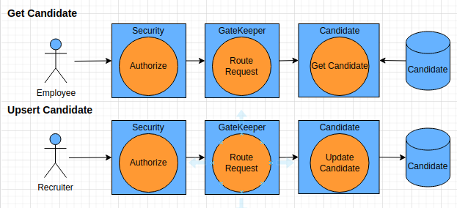
Candidate Service Process Flows

Slide 15
Demo

Slide 16
Questions

